Slide 1



WHAT IS RDS/RBDS?
The European Broadcasting Union (EBU) first introduced the official RDS specification in March 1984 after nearly a decade of development.
The United States officially adopted its own version, called RBDS (Radio Broadcast Data System), on January 8, 1993, though the technical standard framework was completed by the National Radio Systems Committee (NRSC) in late 1992.
tylerwoodward.me
tylerwoodward.me

Slide 2
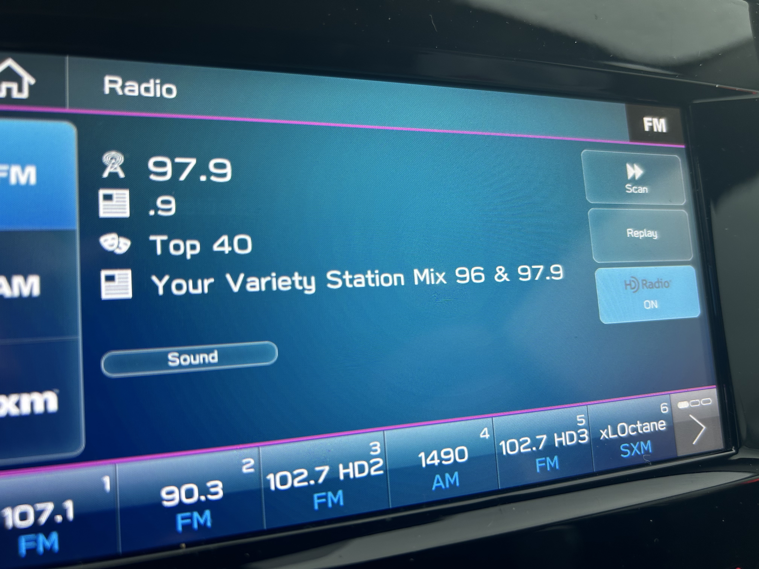
WHAT DOES RBDS DO?
It puts data on your FM signal. Your radio reads it and shows you things — the station name, what song is playing, the format, the time. It's how your car knows you're listening to WLCW instead of just seeing "100.1."
It does this by piggybacking 1,187.5 bps of data on a 57 kHz subcarrier -- silent, automatic, and invisible until something breaks.
tylerwoodward.me
tylerwoodward.me

Slide 3

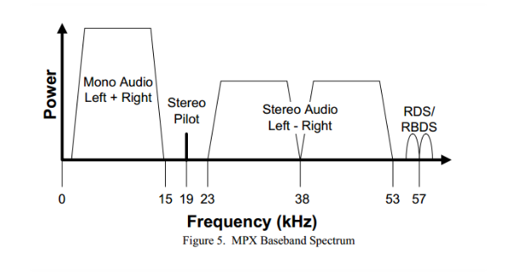
RDS Injection Level
RDS rides on a 57 kHz subcarrier -- exactly 3x the 19 kHz stereo pilot, phase-locked to it. Injection level is how much of your total FM modulation budget the RDS subcarrier consumes. It counts against your composite headroom just like audio does.
TOO LOW, TOO HIGH, AND THE SWEET SPOT...
tylerwoodward.me
tylerwoodward.me

Slide 4
RBDS INJECTION
TOO LOW, TOO HIGH, THE SWEET SPOT
WHAT HAPPENS?
Decode errors, intermittent group loss, receivers that catch RDS for a few seconds then drop it. PI lookups fail silently.
Too low (below ~2%)
Clean decode on virtually all receivers. Reliable group delivery. PI code stable. IEC 62106 and NRSC both land here.
Sweet spot (2-4%)
Eats into audio modulation headroom. Can cause composite clipping if your processor isn't accounting for the subcarrier load.
Too high (above ~5%)
tylerwoodward.me
tylerwoodward.me

Slide 5
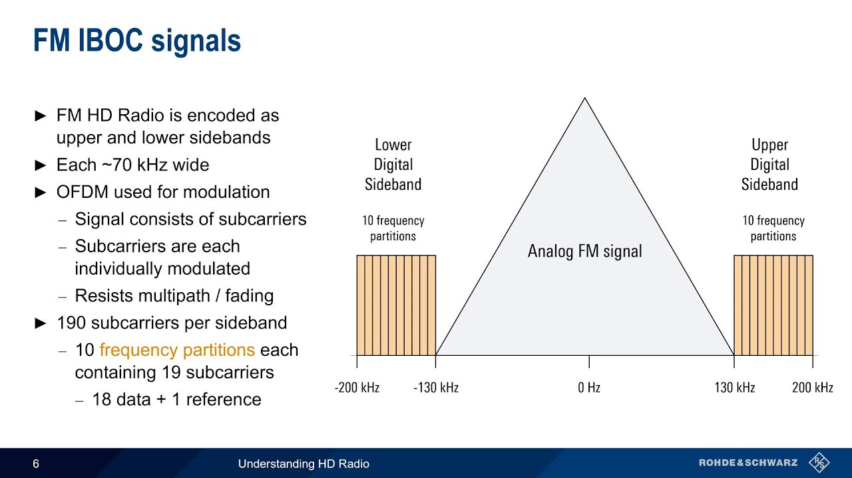
RBDS INJECTION
TOO LOW, TOO HIGH, THE SWEET SPOT
tylerwoodward.me
tylerwoodward.me

Slide 6







RDS Data Fields
What Each One Does
Program Service
RadioText
Program ID
8-character station name on the radio face.
Static. Don’t scroll it.
Group 0A/0B
Now-playing text up to 64 chars. Artist
- Title. Updates each song.
Group 2A
4-digit hex station fingerprint. Used by RadioDNS & AutoStage. Never change it.
All Groups
PS
RT
PI
Program Type
RadioText+
Alt Frequencies
Format code (Rock, News, Country...).
Don't leave it at 0.
All Groups
ODA extension that tags what each part of RT is (title, artist, album, station name).
Group 3A + ODA
Translator list for auto-retuning on a drive. Bad AF = retunes to dead air.
Group 0A
PTY
RT+
AF
tylerwoodward.me

Slide 7




RDS Data Fields
What Each One Does
Music/Speech
Clock Time
Program Type Name
1-bit flag. Lets receivers adjust EQ. Set it correctly for your format.
Group 0A/0B
UTC clock, fires once per minute. Only transmit if it's accurate.
Group 4A
PTYN stands for Program Type Name. It allows a radio station to display a customized, 8-character description of their music genre
Group 3A
M/S
CT
PTYN
Traffic Programming
Traffic Announcement
Decoder Information
Set to 1 if station carries traffic programming.
All Groups
Active traffic announcement. Auto-switching discouraged in the US.
A 4-bit signal that tells your radio how to dynamically process the audio coming from the station
Group 0A/0B
TP
TA
DI
Groups 0A, 0B, 14B, 15B
tylerwoodward.me

Slide 8

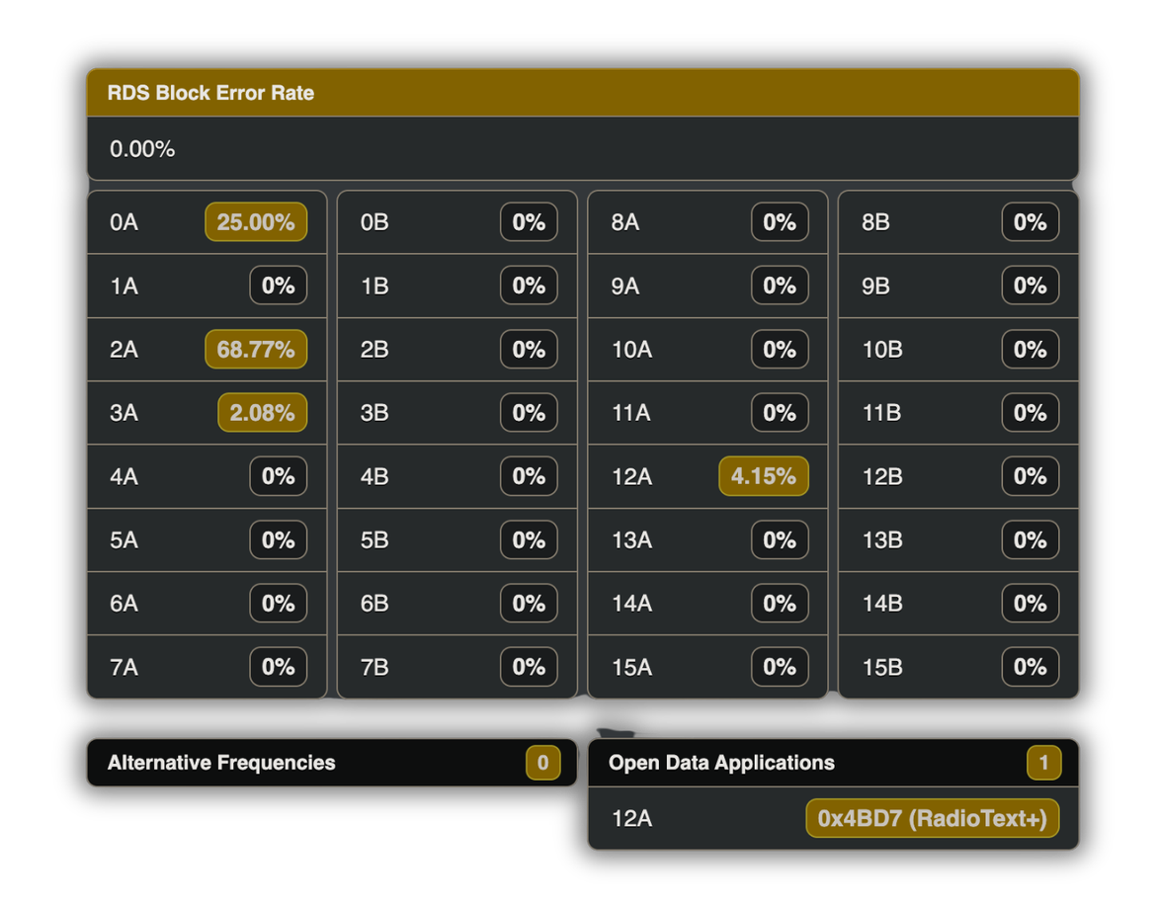




Group Allocation
What Those Percentages Mean??
The Workhorse
PS: Program Service
AF: Alternate Frequency
TP: Traffic Programming
TA: Traffic Announcement
MS: Music or Speech
Sends 4 times every second
RT+ RadioText+ Tagging
0A
While Group 2A sends the actual text ("Blinding Lights by The Weeknd"), Group 12A sends the invisible binary codes that say: "The title starts at letter 14 and is 15 letters long".
Sends every 2 seconds
12A
RT (Standard RadioText)
a 64-character text field that allows FM stations to transmit longer alphanumeric messages directly to your radio's display
Sends 3 times every 2 seconds
2A
What is 4BD7?
It is a "Free Format" group: In the official RDS specifications, Group 12A is originally left blank for custom applications. When Group 3A broadcasts the AID code 4BD7, it tells your radio to specifically use Group 12A for RT+
The AID code: The label that says, "This package contains Radio Text Plus data; open it using your RT+ software."
RT+ Identification Packet
This group acts as the signpost, telling the radio: "Hey, we have RT+ here, and you can find the actual digital tags over inside Group 12A.
Sends every 10 seconds
3A
RDS transmits at 1,187.5 bps. The percentages show how much of that fixed bandwidth each group type consumes.
Common failure: TMC/EON default-on with nothing feeding them → OA and 2A get starved → PS sluggish, RT lags 20-30 sec. Fix: switch off unused groups.

Slide 9
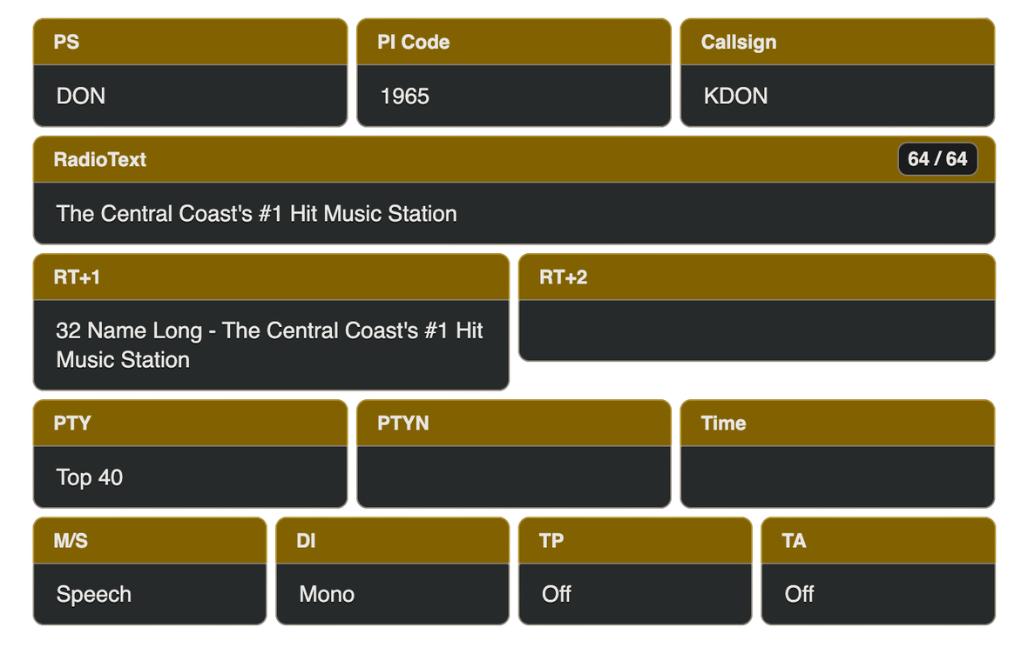

RadioText+
RT+1 & RT+2
RT+1
Common RT+ Content Type Codes
The software in your screenshot uses these fixed numeric identifiers to understand what it is displaying:
  1 = Item.Title (Song Name)
  2 = Item.Artist (Performer)
  3 = Item.Composition (Composer)
  4 = Item.Movement (Classical music section)
  32 = Station Name Long (As seen on your screen)
RT+1
Why is RT+2 Empty?
Stations use RT+1 for single items like station slogans (code 32). The RT+2 box stays empty because there is no second metadata type to tag. When a song plays, the encoder uses both slots simultaneously: RT+1 switches to code 1 (Song Title) and RT+2 switches to code 2 (Artist Name).
RT+2
tylerwoodward.me

Slide 10
Program Type Name
A Little Extra...
Program Type Name
  If the station wants to be more specific than just "Top 40", they can use the PTYN field to broadcast a custom nickname (e.g., HITLIST, CHR, or LIVE MIX)
  It is optional: If a station is perfectly fine with the default label "Top 40", they can leave PTYN completely blank.
  The Data Envelope: PTYN information is transmitted over the inside Group 10A.
  Display Only: Car stereos cannot use the custom PTYN text for automatic tuning or station searching; it is purely visual eye candy for your dashboard.
PTYN
tylerwoodward.me

Slide 11
0 | None | 16 | Rhythm and Blues (R&B)
1 | News | 17 | Religious Music
2 | Information | 18 | Religious Talk
3 | Sports | 19 | Personality
4 | Talk | 20 | Public
5 | Rock | 21 | College
6 | Classic Rock | 22 | Spanish
7 | Adult Hits | 23 | Talk (Spanish)
8 | Soft Rock | 24 | Hip Hop / Rap
9 | Top 40 (CHR) | 25 | N/A
10 | Country | 26 | N/A
11 | Oldies | 27 | N/A
Program Type
It tells your car or home stereo exactly what kind of content is currently broadcasting.
tylerwoodward.me

Slide 12
Program Type
It tells your car or home stereo exactly what kind of content is currently broadcasting.
12 | Soft | 28 | N/A
13 | Nostalgia | 29 | Weather
14 | Jazz | 30 | Emergency Test
15 | Classical | 31 | EMERGENCY ALERT (EAS)
Code 31 (Emergency Alert):
This code is highly protected. When triggered, it forces your car stereo to instantly switch away from your CD, Bluetooth, or auxiliary audio input to broadcast the local Emergency Alert System (EAS) audio.
In the United States, almost no one uses PTY Code 31 anymore.
Because it acts as a "forced hijack," if an engineer accidentally misconfigures a radio station encoder and leaves Code 31 running, it will freeze every car stereo within a 30-mile radius onto that station. Fearing massive FCC fines for disrupting consumer equipment with accidental false alarms, most stations permanently disable the code in their automation software.
tylerwoodward.me

Slide 13



The PI Code
How It Works and Why It Matters Downstream
First Nibble
Second Nibble
Last Two Nibbles
4 bits
4 bits
8 bits
Country code. The US spans multiple country code values across states and regions in the IEC 62106 system - it's not a single digit for the whole country.
Area coverage code. Describes the station's broadcast footprint - local, regional, national, etc.
Program reference number. The station-specific part. For US stations this is calculated from call letters per the NRSC-4-B algorithm.
A 16-bit value displayed as 4 hex characters (e.g., 1965). It's the station's unique fingerprint in the entire RDS ecosystem. It rides in every single RDS group, not as a separate transmission
tylerwoodward.me

Slide 14
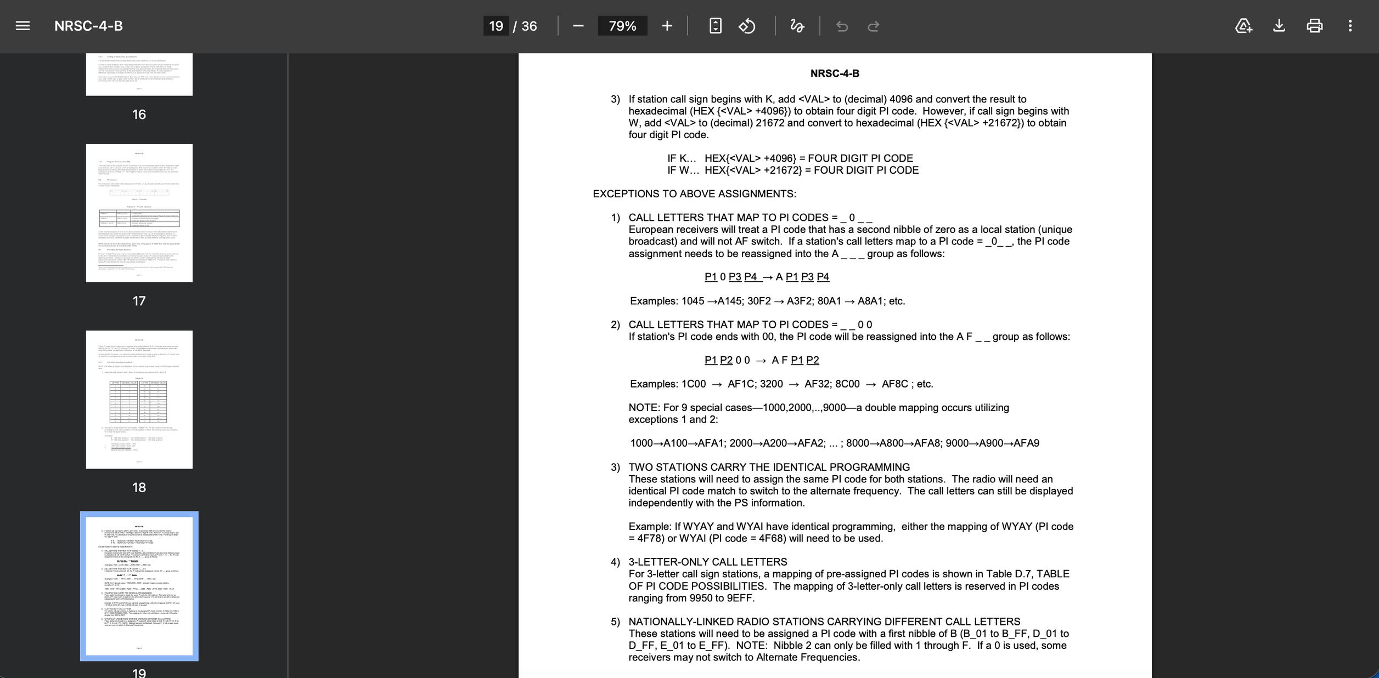
tylerwoodward.me

Slide 15


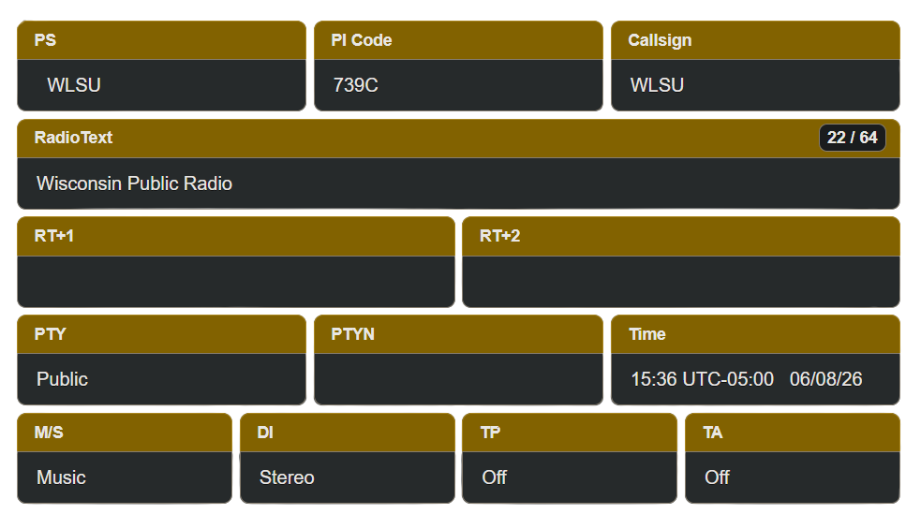

Get this wrong and your translators retune to the wrong station, your AF list breaks, and your RadioDNS lookup goes nowhere. Every system downstream depends on this one code being correct
Your Call Letters, In Hex
739C isn't a random number. It's WLSU, expressed in hex.
https://picodes.nrscstandards.org
tylerwoodward.me

Slide 16
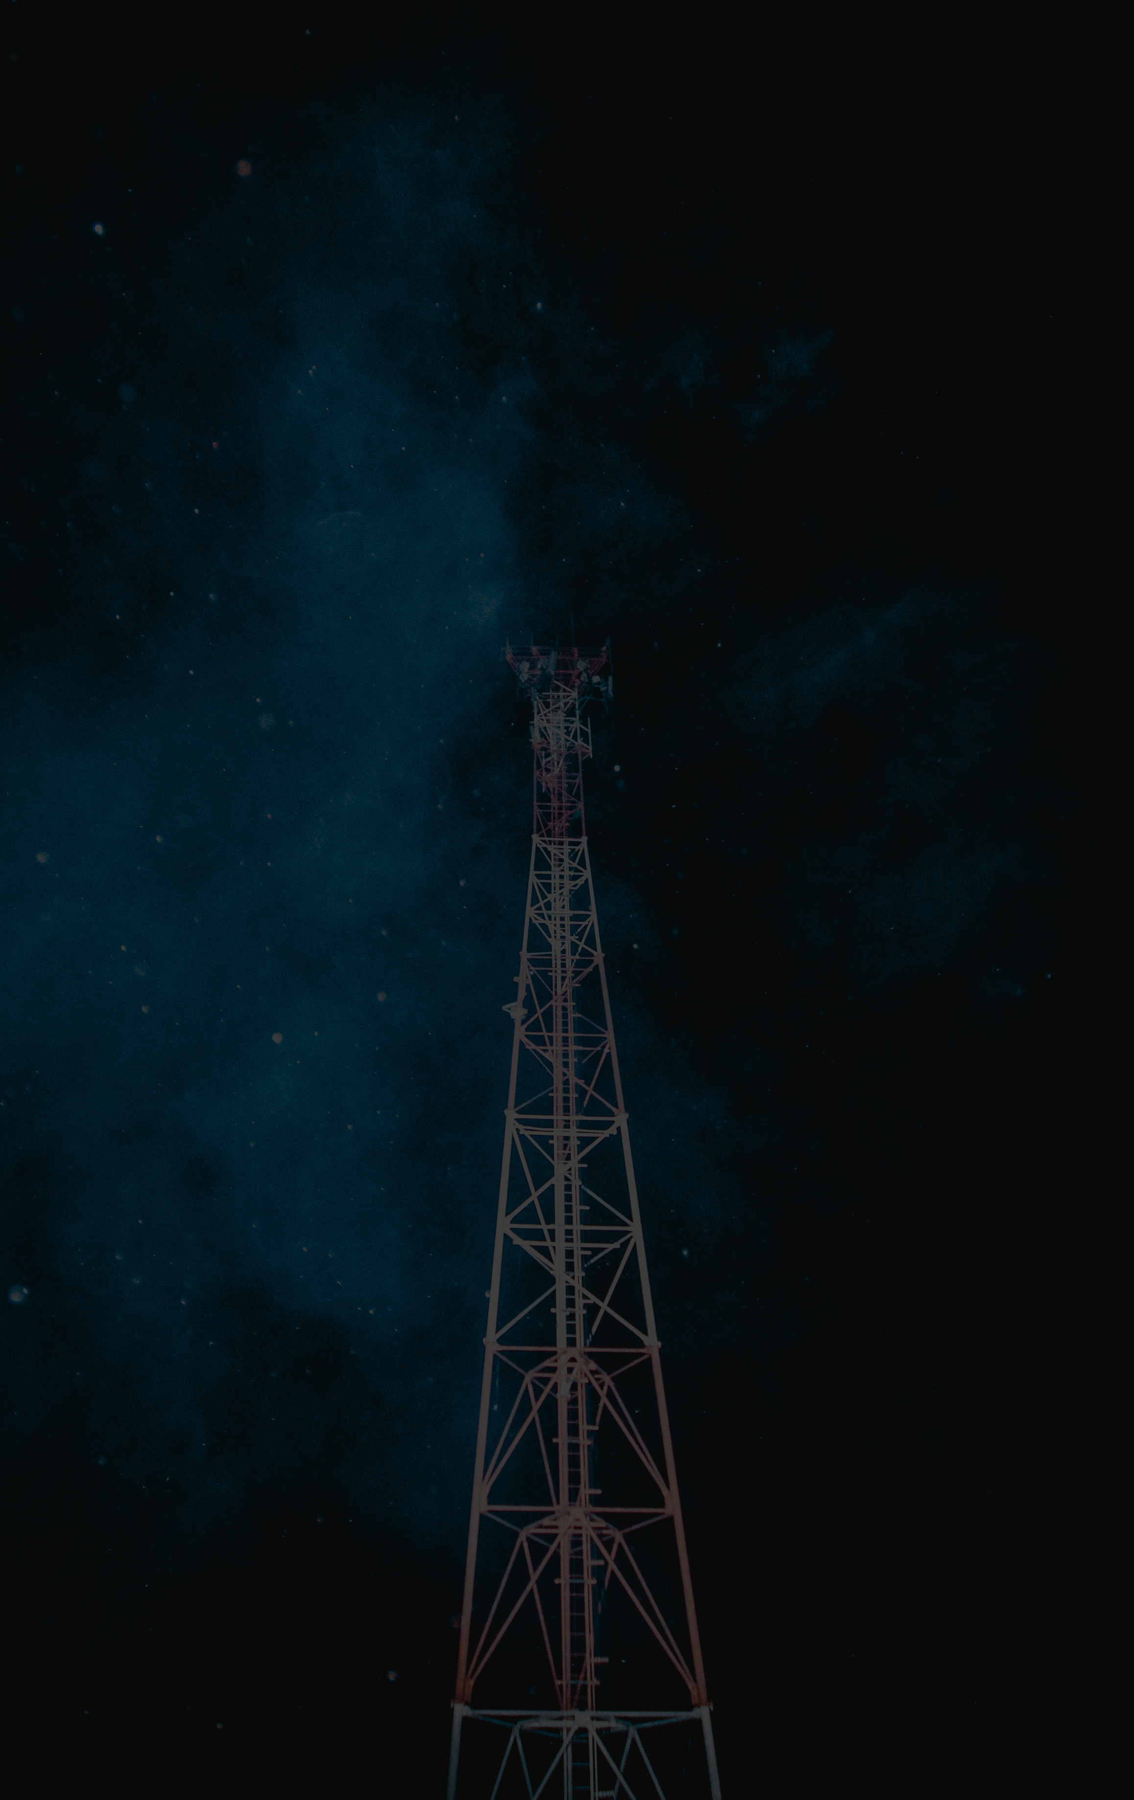
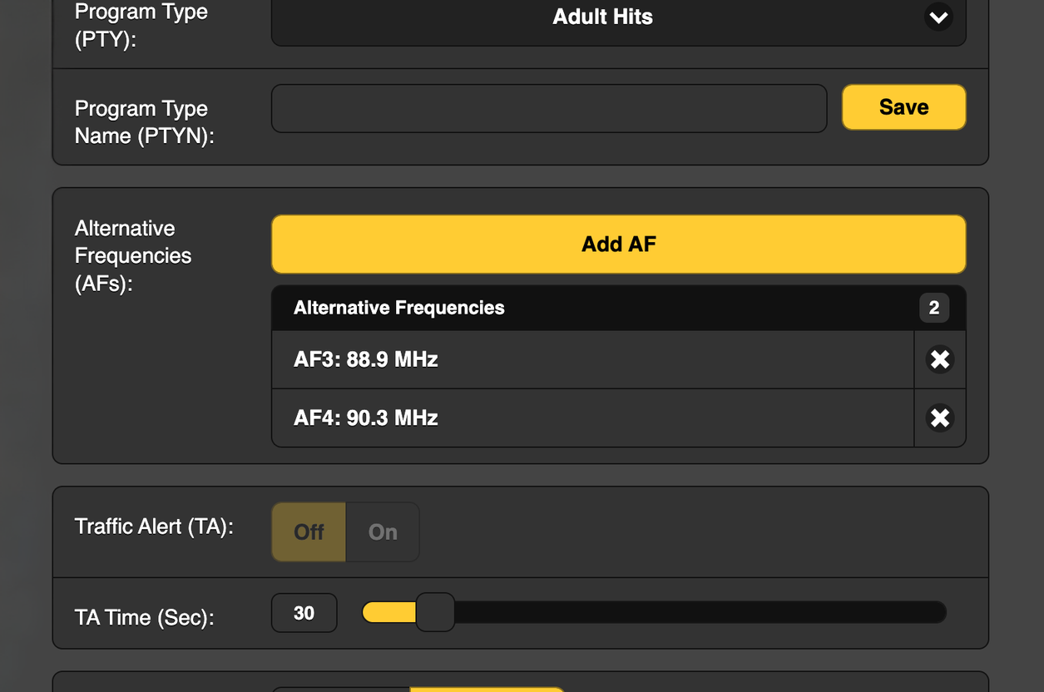
What is AF?
A list of up to 25 frequencies that carry the same programming. Your main signal plus any translators. Stored in Group 0A and broadcast continuously.
tylerwoodward.me

Slide 17


When signal strength drops, the receiver doesn't just jump to the next frequency on the AF list and hope for the best. It tunes there quietly in the background, checks the PI code, and only switches if it matches. The listener never hears it happen.
PI Code: 1313
PI Code: 1313
AF is the first place a wrong PI code costs you listeners. RadioDNS and DTS AutoStage are the next two.
PI Code: 1313
tylerwoodward.me

Slide 18


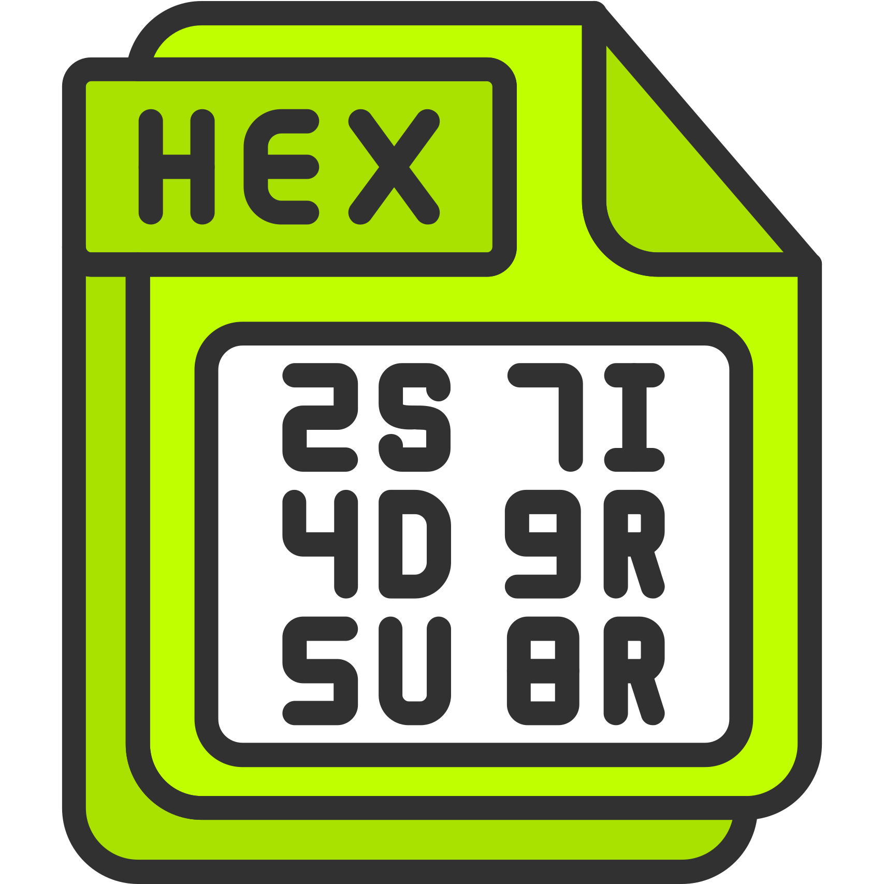



RadioDNS
our PI code and frequency become a DNS lookup. The receiver uses it to find whatever internet services your station has registered — metadata, logos, program guides. Wrong PI code, the lookup goes nowhere.
That PI Code
4 hex digits.
Your station's identity.
PI
DTS AutoStage
The car reads your PI code, sends it to Xperi's platform, and gets back album art and station branding. Wrong PI code means no match — plain text or someone else's content on the display.
*all without HD Radio
tylerwoodward.me

Slide 19



WHO SUPPORTS WHAT?
THE CARS ALREADY LISTENING FOR IT
RadioDNS
DTS AutoStage
Proprietary / RDS only
BMW
Audi
VW Group
BMW
Audi
VW Group
Mercedes-Benz
Ford
Hyundai, Kia, and Genesis
Tesla
GM
tylerwoodward.me

Slide 20





THE ENCODER DOESN'T KNOW WHAT'S PLAYING
YOU HAVE TO GIVE IT INPUT LIKE JOHNNY 5
API, TCP/IP, or Serial/FTP
Satellite Receiver
Middleman Software
RBDS Encoders
(External and TX)
BE TREplus
MetaRadio
Xperi RAPID
ENCO PADapult
Pira MagicRDS
Inovonics
Omnia
Nautel
GatesAir
DEVA
WorldCast Systems (Audemat)
Pira
WorldCast Ecreso FM
Rohde & Schwarz
HTTP, XML feeds, file-based polling, and UDP
UECP over TCP/IP, ASCII over
TCP/IP, HTTP POST / GET,
and RS-232/Serial
Playout System
Web Browsers
(Firefox, Edge, Chrome, etc)
On-Air Staff Input
tylerwoodward.me

Slide 21

BEST PRACTICES
WHAT GOOD LOOKS LIKE
RadioText
PS Name
PI Code
PTY
Dynamic. Artist - Title. Updated on every song change. Both RT and PS -- car displays vary on which field they show.
Static. 8 characters. Call letters or brand name. Never scroll it.
Set correctly per NRSC-4. Never change it. Verify with FCCdata.org. Translators need the NRSC translator PI table.
Set accurately for your format. Leave it alone. Do not leave it at 0.
TP/TA
AF List
DTS AutoStage
Group Allocation
Only set TP if you actually carry traffic. Never leave TA stuck on.
List every translator and same-format frequency accurately. Test by driving -- does the radio retune correctly?
Register your station. Upload logos in all required sizes. Connect automation to push now-playing in real time. Free to participate.
0A: 40-60%. 2A: 20-30% if using dynamic RT. 4A: 5-10%. Disable every group not in use. Check for TMC and EON running by default.
RadioDNS
Monitor, Monitor!
Host an SI XML file on a public web server. Create the DNS records. Register with RadioDNS. Required for Audi, VW, Porsche, BMW hybrid radio listeners.
Inovonics 551 for HD stations. Inovonics 541 for FM-only. RTL-SDR for free spot-checking. RDS doesn't fail loudly -- it just quietly sends wrong data.
tylerwoodward.me

Slide 22




WRAP UP AND GOTCHAS
HD Radio PSD does NOT use the PI code
Most US stations do NOT use RBDS for EAS
AutoStage works without HD Radio and without RDS (sort of)
The listener experience gap is real and visible
HD Radio has its own PAD/PSD delivery mechanism. The PI code is an FM RDS thing. RadioDNS and AutoStage both need the FM RDS PI. If someone asks 'does HD Radio help with RadioDNS,' the answer is no -- the FM RDS subcarrier has to be there and correct regardless of whether the station has HD.
The capability exists in the spec. Group 3A can carry Open Data Applications including EAS. The Inovonics 730 + SAGE ENDEC 3644 integration can do it. But the vast majority of US stations are not using it, and most receiver implementations don't act on it.
A Spotify or SiriusXM stream on the same head unit shows album art, branding, and metadata instantly. An FM station with broken RDS shows a frequency and nothing else. AutoStage and RadioDNS exist to close that gap. Stations that ignore it are choosing to look worse than a streaming service on their own listeners' dashboards.
AutoStage can fall back to geo-location to identify a station if RDS is absent or broken. But to get the PI-based lookup chain working correctly, the RDS subcarrier has to be present and the PI has to be right. Geo-fallback is a crutch, not a design strategy.
tylerwoodward.me

Slide 23
RESOURCES AND LINKS
EXTRA GOODIES
HTTPS://WWW.NRSCSTANDARDS.ORG/
HTTPS://WWW.RADIOWORLD.COM/RESOURCE-CENTER/RDS-BASICS-BEST-PRACTICES
HTTPS://DTS.COM/AUTOSTAGE/
HTTPS://RADIODNS.ORG/
HTTPS://PICODES.NRSCSTANDARDS.ORG/
tylerwoodward.me

